Slide 1
Chapter 2 Problem Solving

Slide 2
Overview
2.1 Defining problems as a state space search
2.2 Problem Formulation
2.3 Problem Types, Well-defined problems, Constraint Satisfaction Problem
2.4 Game Playing, Production Systems

Slide 3
2.1 Defining a Problem as a State Space Search
Problem
A problem is a situation (difficult/easy) experienced by an agent.
Problem is solved by a sequence of actions that reduce the difference between the initial situation and the goal.
A problem is defined by its elements and their relations. To provide a formal description of a problem, we need to do following:
Define the problem precisely: find input situations as well as final situations for acceptable solution to the problem.
Analyze the problem: find few important features that may have impact on the appropriateness of various possible techniques for solving the problem.
Isolate and represent task knowledge necessary to solve the problem.
Choose the best problem solving techniques and apply to the particular problem.

Slide 4
2.1 Defining a Problem as a State Space Search
Problem solving methods divide into 2 categories:
1. Special Purpose Method.
A special-purpose method is tailor-made for a particular problem and often exploits very specific features of the situation in which the problem is embedded.
2. General Purpose Method
A general-purpose method is applicable to a wide variety of problems.
A problem is characterized by a set of goals, a set of objects, a set of operations

Slide 5
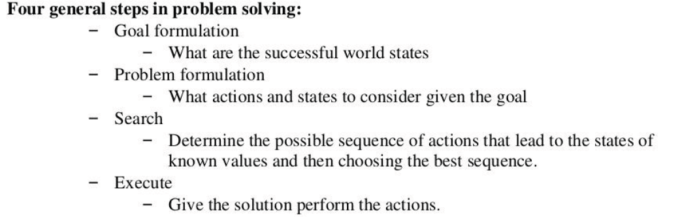
Problem Solving

Slide 6
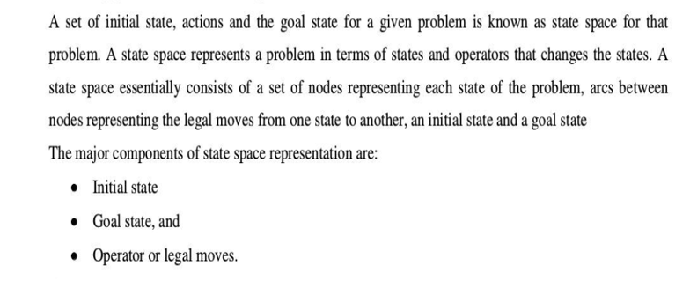
2.1 Defining Problem as a State Space Search

Slide 7
2.1 Defining Problem as a State Space Search
The major components of state space representation:
Initial State :- is the start state
Goal State:- is the conditions that has to be fulfilled. It consists of the description of a desired state of the world; the description may be complete or partial.
Operators:-are to change the state. Operators do actions that can transform one state into another. Operators consist of : Preconditions and Instructions; Preconditions provide partial description of the state of the world that must be true in order to perform the action while Instructions tell on how to create next state. Operators should be as general as possible, to reduce their number.

Slide 8
Q. Explain problem as a state space with an example.

Slide 9
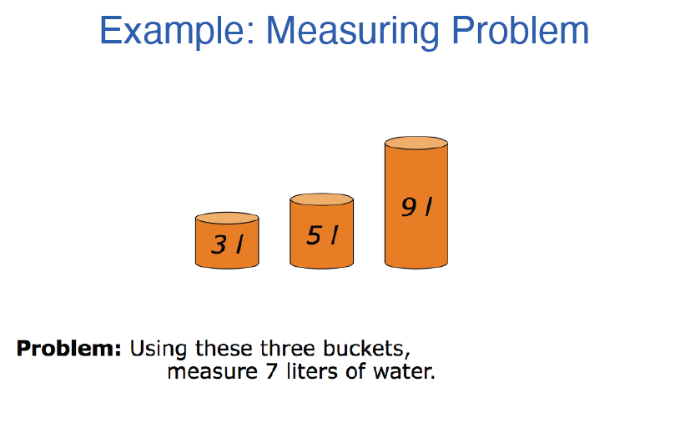
Example 1: Measuring Problem

Slide 10
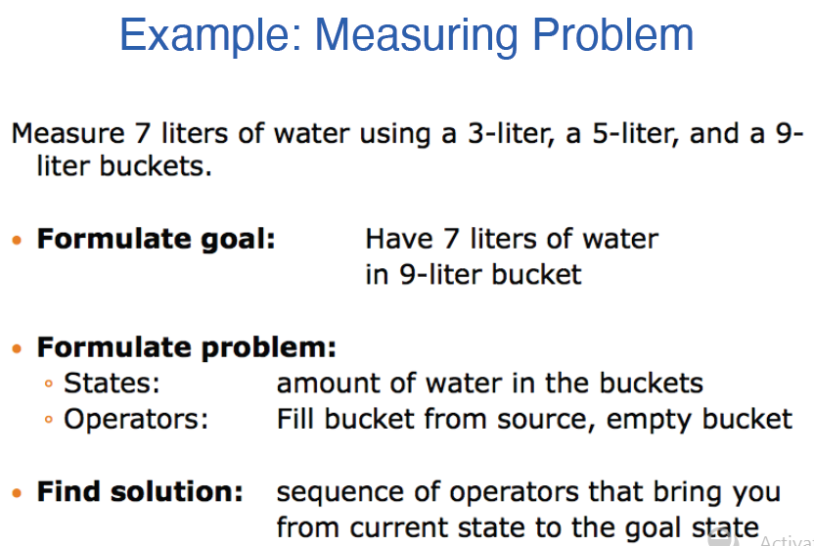
Example 1: Measuring Problem

Slide 11
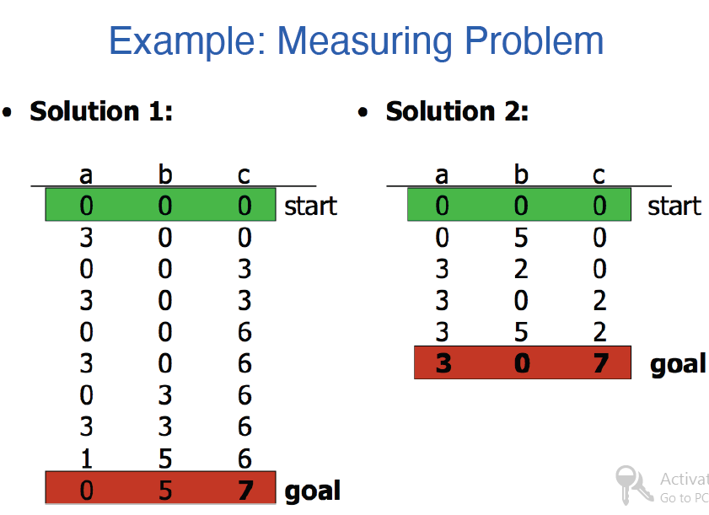
Example 1: Measuring Problem

Slide 12

Example 2: The 8-puzzle
The puzzle consists of an 8-square frames and an empty slot. The tiles are numbered from 1-8. It is possible to move the tiles in the square field by moving tile into the empty slot. The objective is to get square in a numeric order.

Slide 13
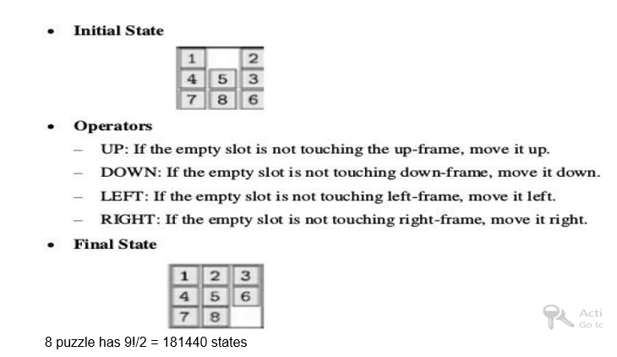
Example 2: The 8-puzzle

Slide 14
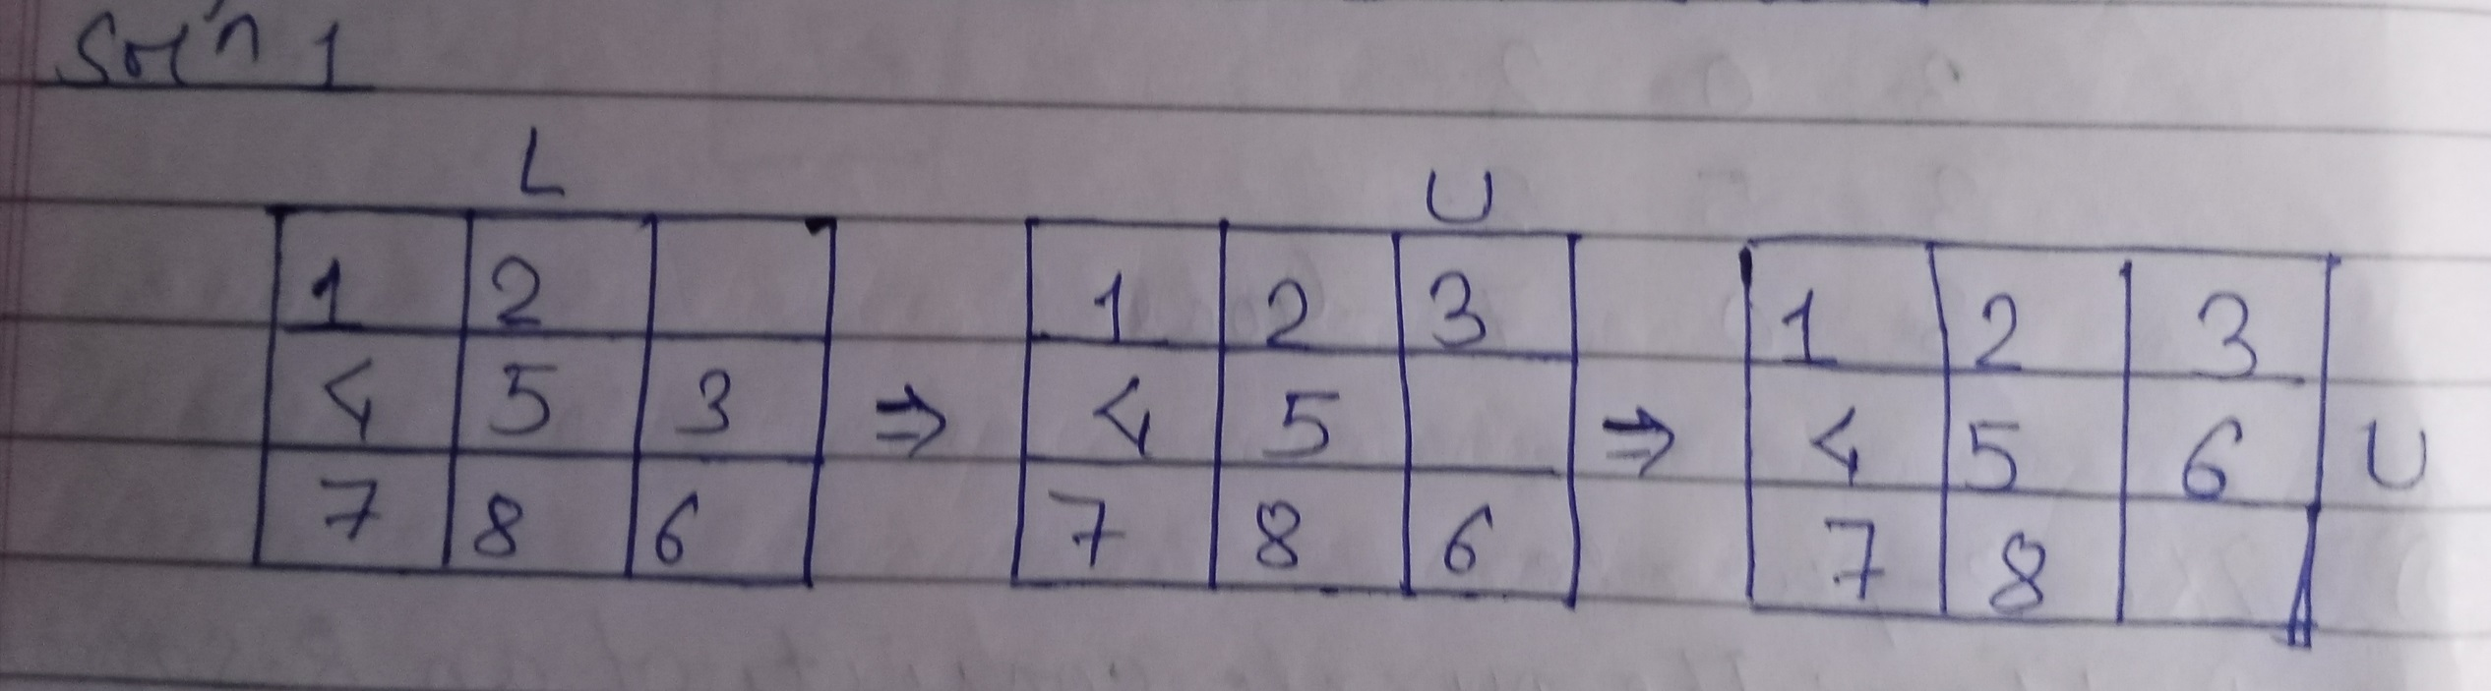
Example 2: The 8-puzzle

Slide 15
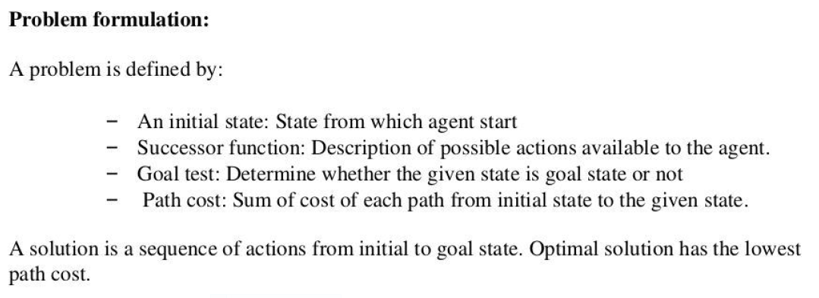
2.2 Problem Formulation

Slide 16
2.3 Problem Types
1. Single state problem = deterministic, accessible
Agent knows everything about the world (the exact state)
Can calculate optimal action sequence to reach the goal
E.g. playing chess, any action will result in an exact state.
2. Multiple state problem = deterministic, inaccessible
Agent doesn’t know the exact state (could be in any of the possible states)
Assume states while working towards the goal state.
E.g. walking in a dark room

Slide 17
2.3 Problem Types
3. Contingency Problem = non-deterministic, inaccessible
Must use sensors during execution
Solution is a tree or policy
Often interleave search and execution
E.g. a new skater in an arena i.e. sliding problem and many skaters around
4. Exploration Problem = unknown state space
Discover and learn about environment while taking actions.
E.g. Maze

Slide 18
2.3 Problem Types
Well Defined Problems
Constraint Satisfaction Problem

Slide 19
Well Defined Problems
A problem is called as well defined if it consists of these 4 important components:
Initial state: The state where an agent starts in.
Successor function: Given a state x, SUCCESSOR-FN(x)returns a set of < action, successor> ordered pairs. The initial state and successor function define the state space.
Goal test : Whether the given state is a goal state?
Path cost: Assigns numeric cost to each path. Step cost for taking action from state x to y-denoted by c(x,a,y).

Slide 20
Well Defined Problem
Solutions
A solution to a problem is a path from initial to a goal state.
An optimal solution has the lowest path cost among all solutions i.e. solution cost is measured by the past cost.

Slide 21
Example 1: Visiting to Romania
Problem: On holiday in Romania; currently in Arad. Flight leaves tomorrow for Bucharest.
Solution:
Step 1: Formulate goal:
be in Bucharest
Step 2: Formulate problem:
states: various cities
actions: drive between cities
Step 3: Find solution:
sequence of cities, e.g., Arad, Sibiu, Fagaras, Bucharest

Slide 22
Example 1: Visiting to Romania
Now, the problem is defined by four items:
1.Initial State: “At Arad”
2. Actions or Successor Function S(x) = set of (action, successor):
e.g., from the state In(Arad), the successor function would be:
{Go(Sibiu),In(Sibiu)}, {Go(Fagaras),In(Fagaras)}, {Go(Bucharest),In(Bucharest)}
3. Goal Test: x = "at Bucharest“,
4. Path Cost: sum of distances

Slide 23
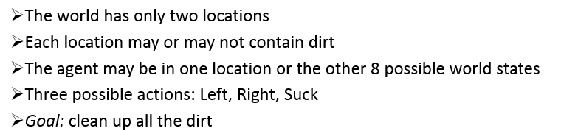
Example 2: Vacuum World

Slide 24
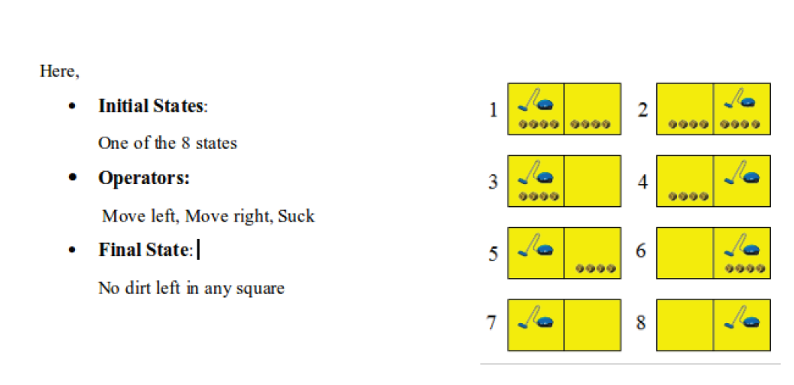
Example 2: Vacuum World

Slide 25
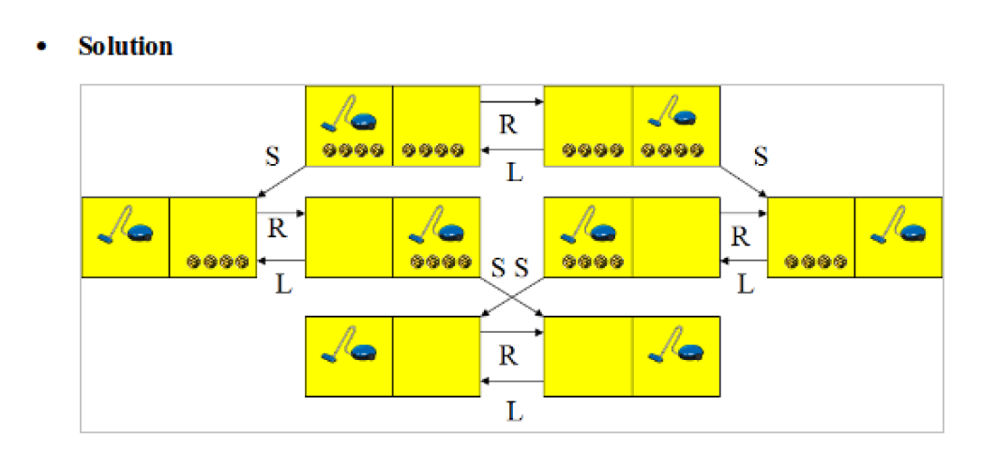
Example 2: Vacuum World

Slide 26
Constraint Satisfaction Problem
Constraint satisfaction problems (CSPs) are mathematical questions defined as a set of objects whose state must satisfy a number of constraints or limitations.
The process of finding a solution to set of variables Vi (V1, V2, …, Vn ) and a set of constraint Ci (C1, C2, …, Cm)
There is no any specified rule to define the procedure to solve the CSP.
E.g. : river crossing problem, 8-queens problem, Crypto Arithmetic Problems

Slide 27
Example 1: River Crossing Problem
Problem: In a distinct land, bigamy is common. There are six people who want to cross a river in this land. This group consists of two men, each two wives. No man can tolerate any of his wives being in the company of another man unless atleast he or his next wife is present in the boat or in next land. There is a boat that holds two people to be used for crossing the river. How is the trip possible?

Slide 28
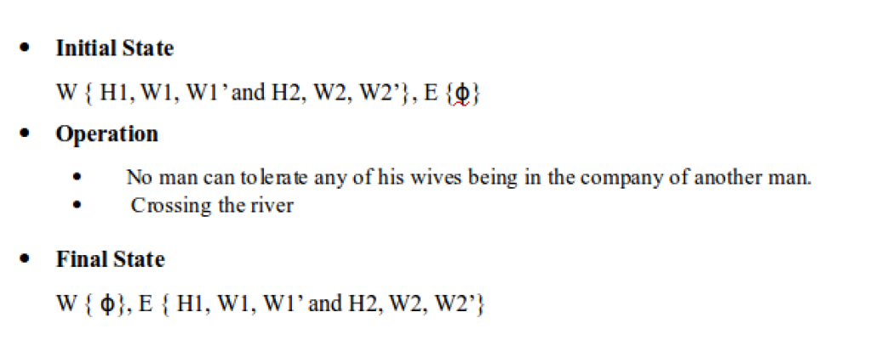
Example 1: River Crossing Problem

Slide 29
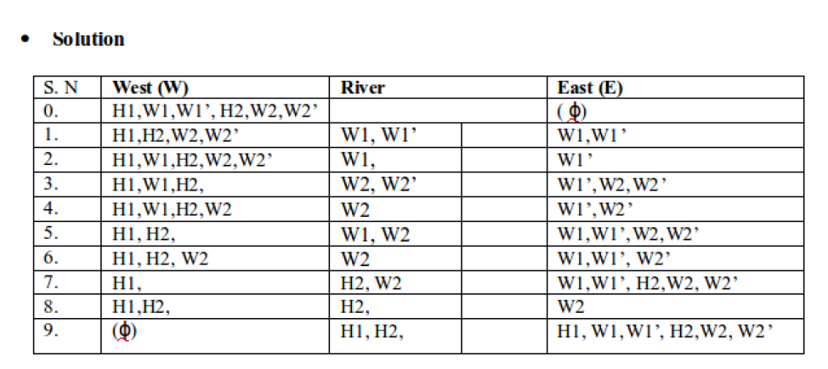
Example 1: River Crossing Problem

Slide 30
Example 2: 8 Queen’s Problem
Problem: The problem is to place 8 queens on a chessboard so that no two queens are in the same row, column or diagonal.
Solution:
Initial state: No queens on the board
States: Any arrangement of 0 to 8 queens on the board
Successor function: Add a queen to an empty square
Goal Test: 8 queens on the board and none are attacked
64*63*…*57 = 1.8*1014 possible sequences

Slide 31
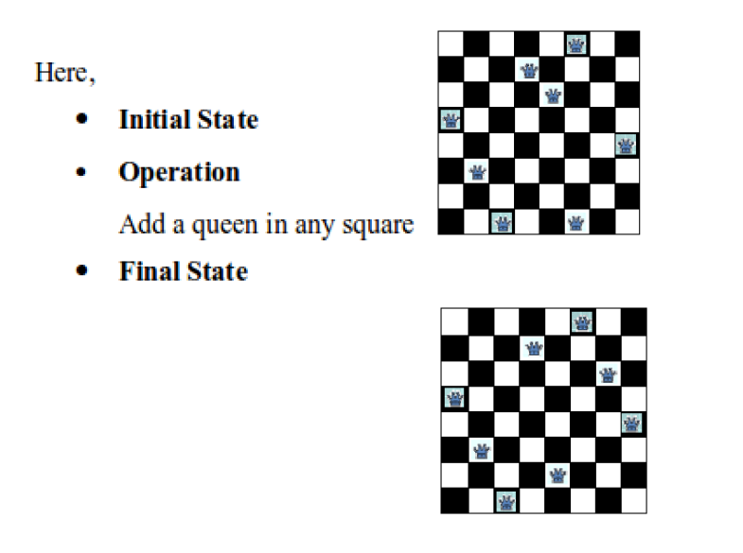
Example 2: 8 Queen’s Problem

Slide 32
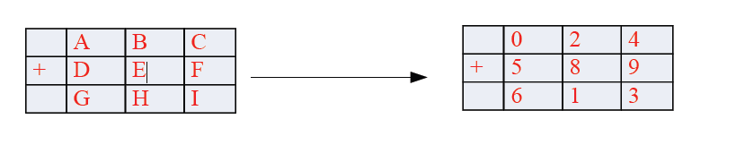
Example 3: Crypto Arithmetic Problems
Crypto-Arithmetic Problems are substitution problems where digits representing a mathematical operation are replaced by unique digits.
E. g:

Slide 33
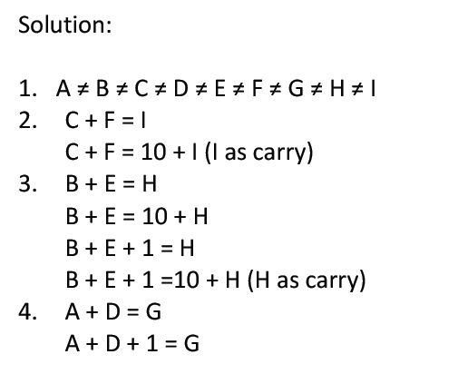
Example 3: Crypto Arithmetic Problems

Slide 34
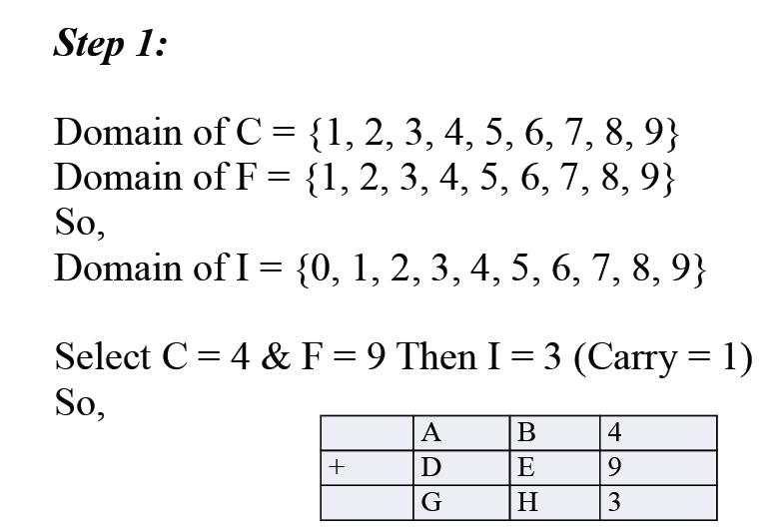
Example 3: Crypto Arithmetic Problems

Slide 35
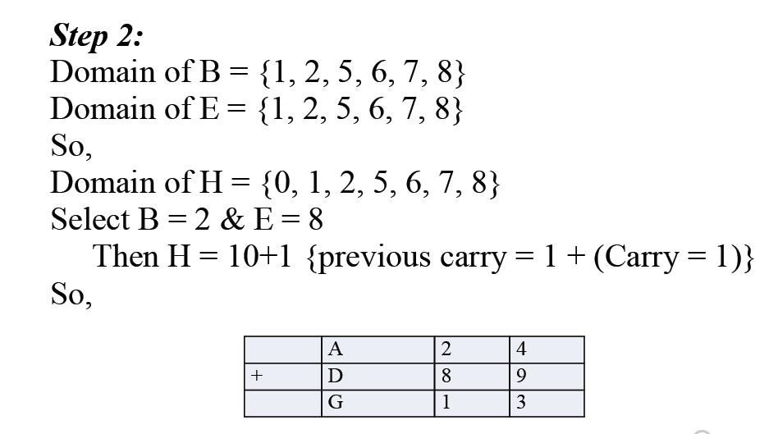
Example 3: Crypto Arithmetic Problems

Slide 36
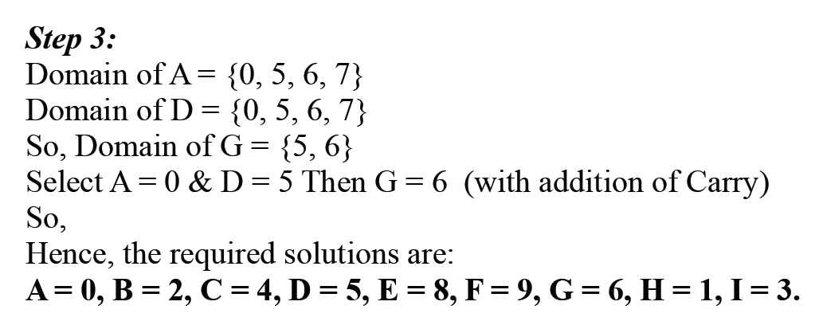
Example 3: Crypto Arithmetic Problems

Slide 37
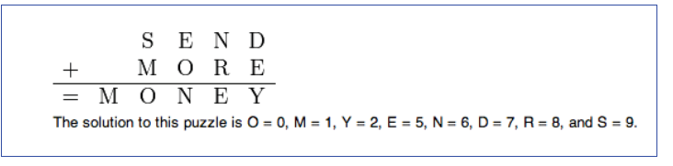
Example 3: Crypto Arithmetic Problems

Slide 38
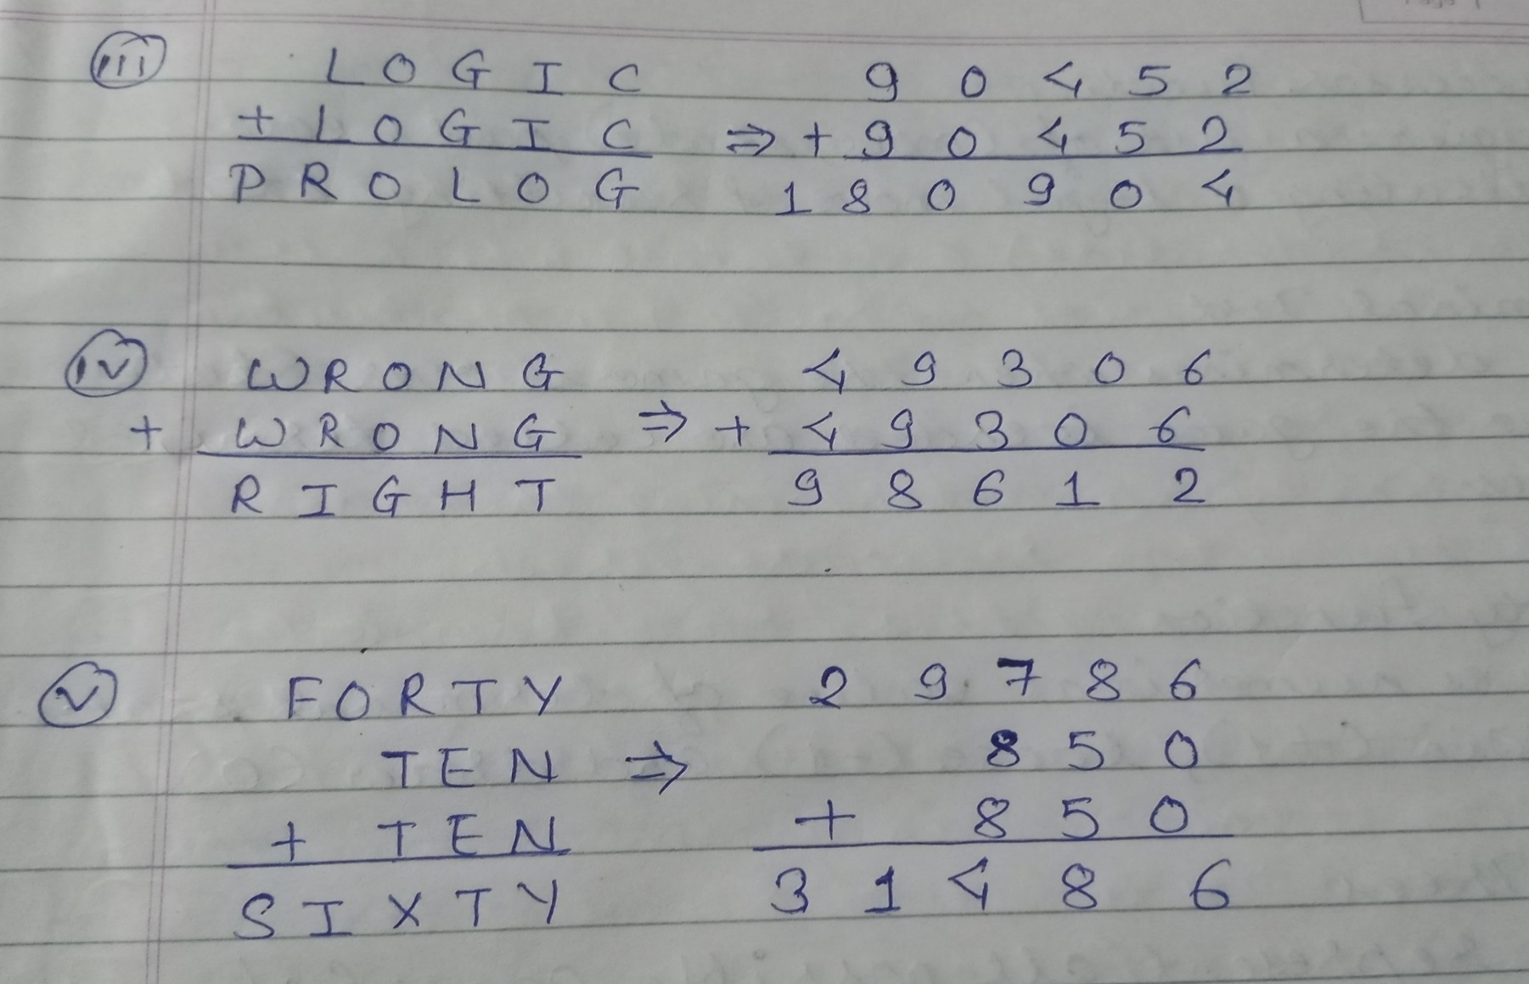
Example 3: Crypto Arithmetic Problems

Slide 39
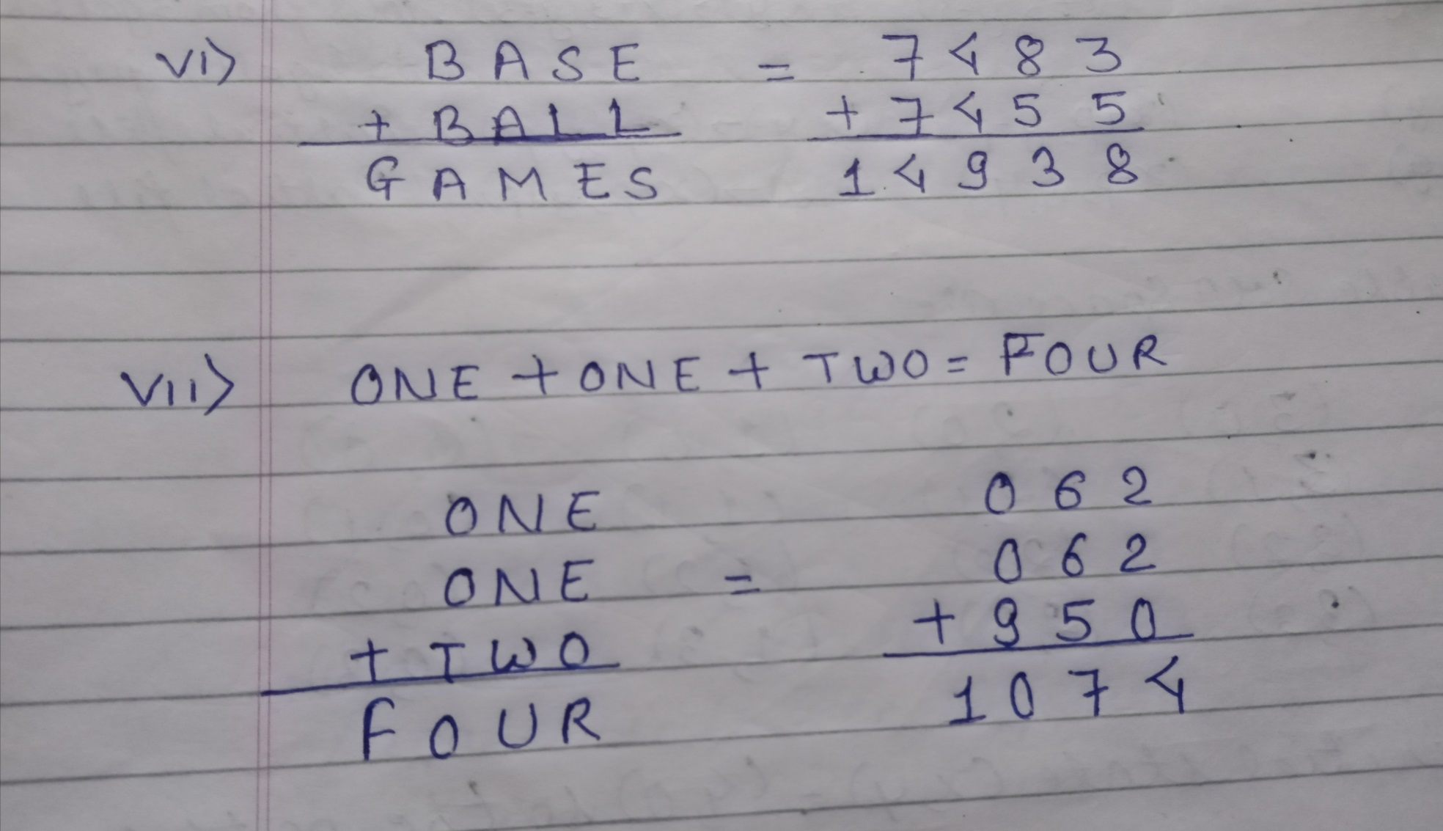
Example 3: Crypto Arithmetic Problems

Slide 40
2.4 Game Playing and Production Systems
Game Playing
A game can be formally defined as a kind of search problem as below:
Initial state: It includes the board position and identifies the player’s to move.
Successor function: It gives a list of (move, state) pairs each indicating a legal move and resulting state.
Terminal test: This determines when the game is over. States where the game is ended are called terminal states.
Utility function: It gives numerical value of terminal states. E.g. win (+1), loose (-1) and draw (0).

Slide 41
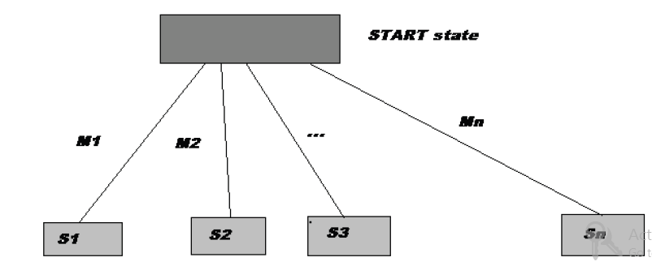
2.4 Game Playing and Production Systems
Game Trees
We can represent all possible games(of a given type) by a directed graph often called a game tree.
The nodes of the graph represent the states of the game. The arcs of the graph represent possible moves by the players (+ and -).

Slide 42
Example: Tic-tac-toe
There are two players denoted by X and O.
They are alternatively writing their letter in one of the 9 cells of a 3 by 3 board.
The winner is the one who succeeds in writing three letters in line.
The game begins with an empty board. It ends in a win for one player and a loss for the other, or possibly in a draw.
A complete tree is a representation of all the possible plays of the game.
The root node is the initial state, in which it is the first player's turn to move (the player X).
The successors of the initial state are the states the player can reach in one move, their successors are the states resulting from the other player's possible replies, and so on.

Slide 43
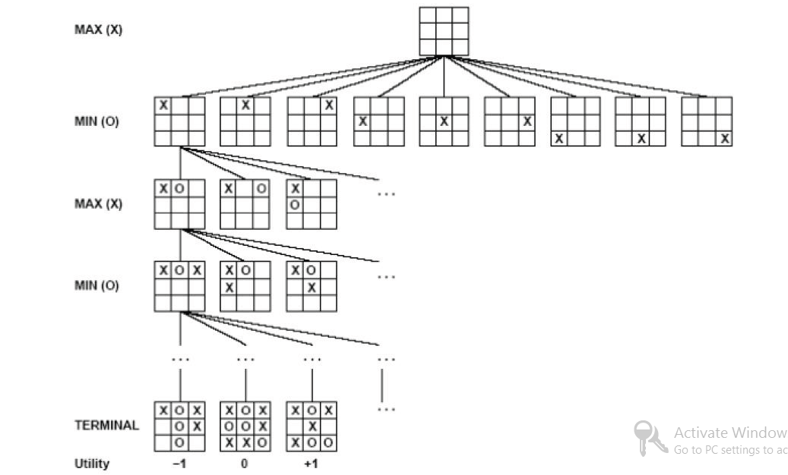
Example: Tic-tac-toe

Slide 44
2.4 Game Playing and Production Systems
Production Systems
A Knowledge representation formalism consists of collections of condition-action rules(Production Rules or Operators), a database which is modified in accordance with the rules, and a Production System Interpreter which controls the operation of the rules i.e. The 'control mechanism' of a Production System, determining the order in which Production Rules are fired.
A system that uses this form of knowledge representation is called a production system.
A production system consists of rules and factors. Knowledge is encoded in a declarative form which comprises of a set of rules of the form:
Situation ------------ Action
SITUATION that implies ACTION.

Slide 45
Example: Water Jug Problem
Problem: You are given two jugs, a 4-gallon one and a 3-gallon one. Neither has any measuring marker on it. There is a pump that can be used to fill the jugs with water. How can you get exactly 2 gallons of water into the 4-gallon jug? Solve by production rule system.
Solutions:
Given: 4 gallon jug, 3 gallon jug and 2 gallon is to be measured in 4 gallon jug.
Let 4 gallon jug represent x and 3 gallon jug represent y.
So, initial state is (x, y) and final state is (2,*)

Slide 46
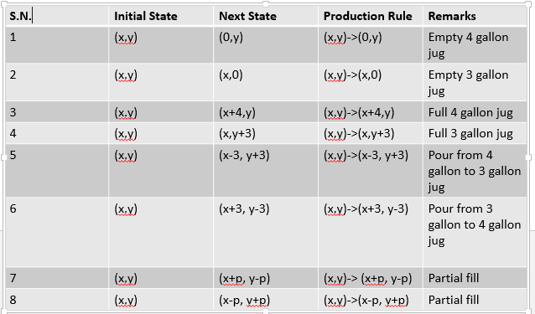
Example: Water Jug Problem

Slide 47
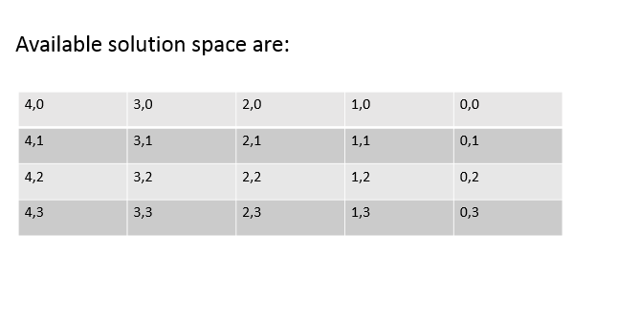
Example: Water Jug Problem

Slide 48
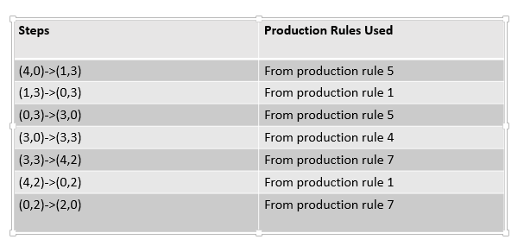
Example: Water Jug Problem
Let the initial state (x, y) = (4,0) so the path can be:
(4,0)->(1,3)->(0,3)->(3,0)->(3,3)->(4,2)->(0,2)->(2,0)

Slide 49
References
E. Rich and Knight, Artificial Intelligence, McGraw Hill, 1991.
D. W. Patterson, Artificial Intelligence and Expert Systems, Prentice Hall, 2001.

